Slide 1


Intro to MATLAB Programming

Slide 2

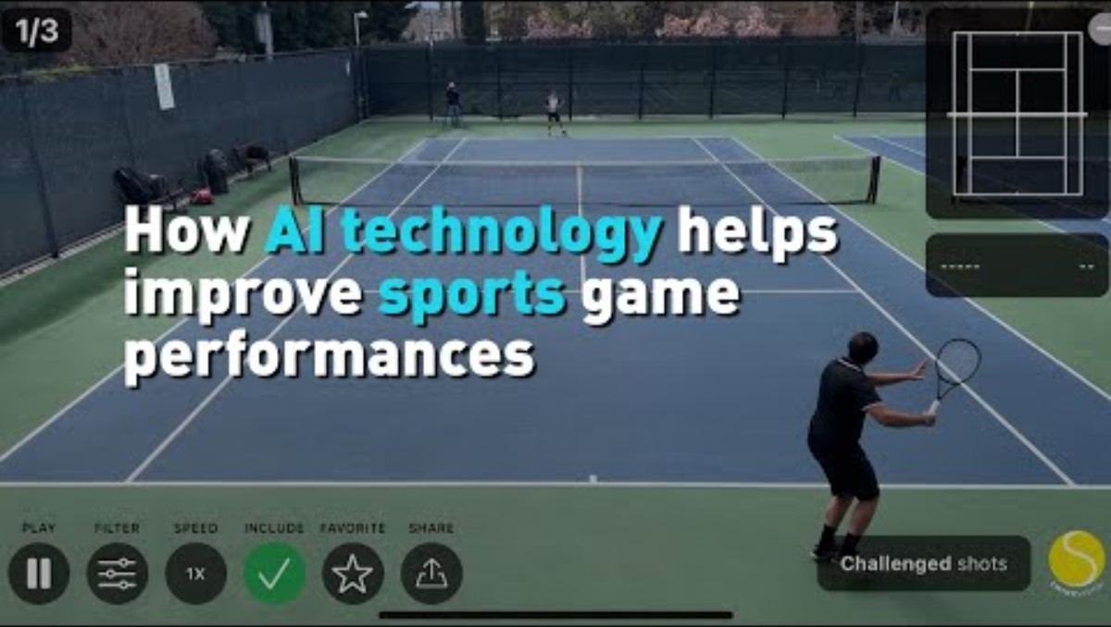

How Can We Use Programming to Predict Sports and Top Tracks?
Let’s look at this video about using programming to predict a player’s performance in the NBA:

Slide 3
How Can We Use Programming to Predict Sports and Top Tracks?
After watching this video, let’s discuss the following questions:
Tools like the one in this video need a lot of data to be trained on. Why do you think getting plenty of data is important for making good predictions?
How do you think programs like these store different types of data? Would a player’s name be stored in a different way than player’s average score per game (name vs. number)?
What other places could you apply a tool like this? How might something like this be useful for working in the music industry?

Slide 4



How Can We Use Programming to Predict Sports and Top Tracks?
Let’s see how the music industry compares to sports and what kind of data they look at when making predictions:

Slide 5


How Can We Use Programming to Predict Sports and Top Tracks?
Let’s discuss:
How does the music industry differ from the sports industry? For sports the focus is on the athlete, but is music solely data generated by the artists?

Slide 6
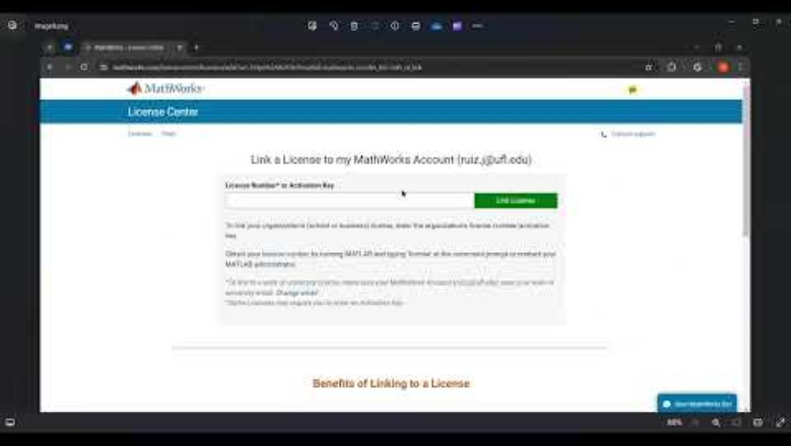
Before We Get Started!
We need to create a MathWorks account to use the MATLAB online tool!
Please watch the video below on how to create a MathWorks Account:

Slide 7
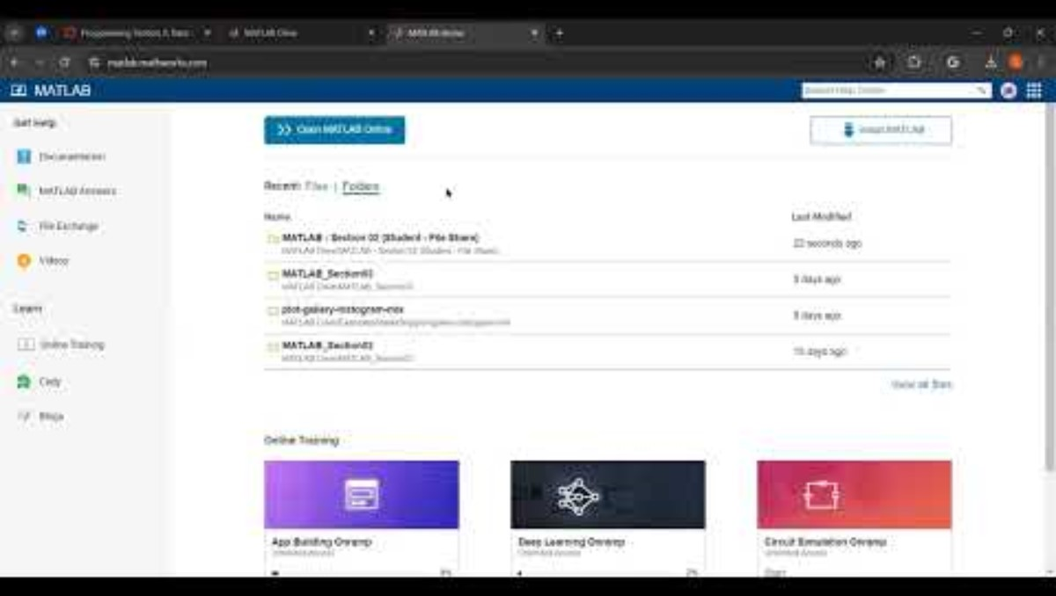
Now That We Have a MathWorks Account
We need to be able to grab our live scripts (code) from the MATLAB Drive!
Please watch the video below on how to access the MATLAB Drive and copy files over to your own MATLAB Drive so you can make edits:

Slide 8
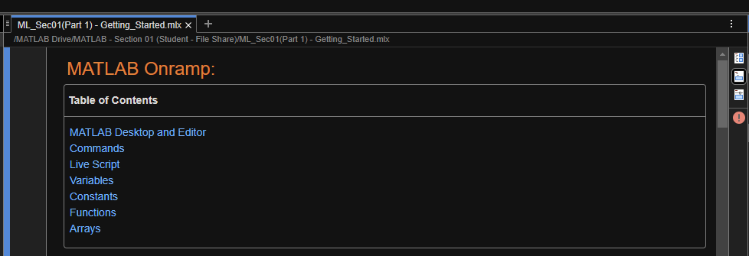
Getting Started With MATLAB Onramp
Please copy over the files for Section 01 from the MATLAB Drive, you can find the link at the top of the PDF or Handout
Please refer to the video on the previous slide on how to copy files over from the MATLAB Drive to your own.
Remember that you may need to exit MATLAB by clicking your profile in the top right and re-opening the MATLAB online tool for the files to appear.
‘
The MATLAB files for this section can be found at this link.
Notes:
The URL on this slide is for the student version of the files, please see the teacher guide for the teacher version of the files You can also find the teacher and student links on the master document with all the youtube video and matlab drive links for every section on it

Slide 9
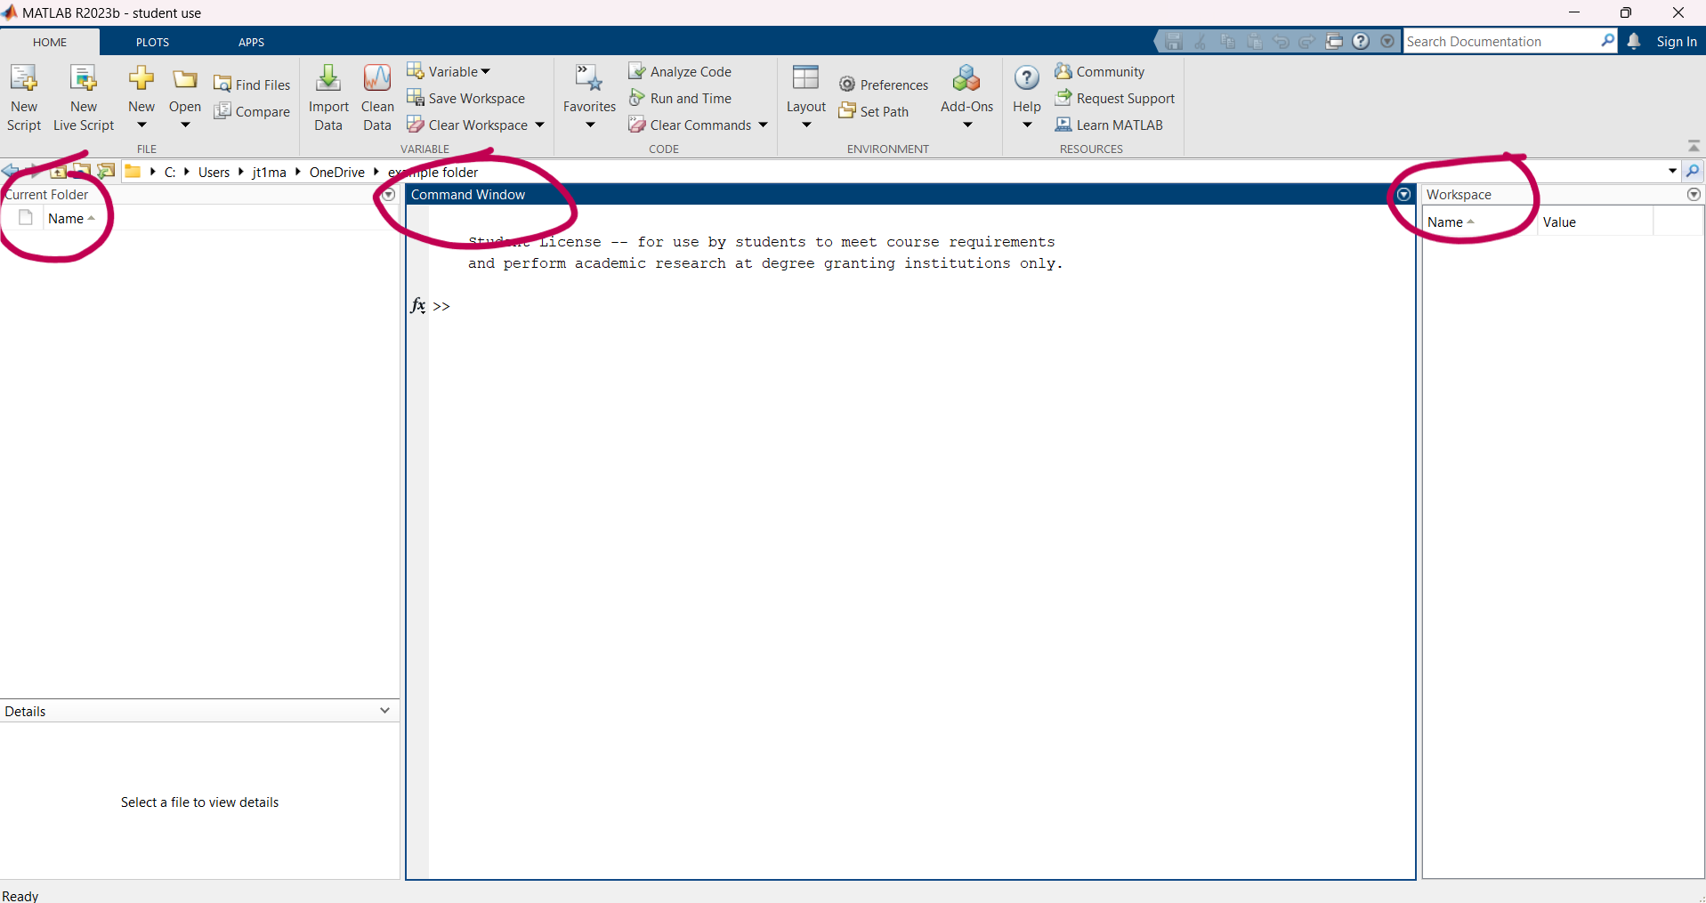
Getting Started With MATLAB Onramp
MATLAB Desktop and Editor
The default layout contains three main windows: the Command window, the Workspace, and the Current Folder.

Slide 10
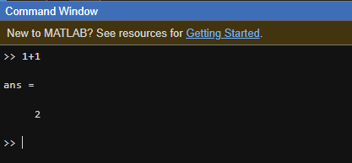
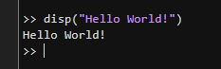
Getting Started With MATLAB Onramp
Commands
You can execute commands by typing them in the Command Window after the MATLAB prompt (>>) and pressing the Enter key.
The answer will continue below and will save itself in the workspace. If it isn't entered as variable, the output will save itself as ans.
Entering commands one by one in the Command window is a quick way to try something out and see the results.

Slide 11
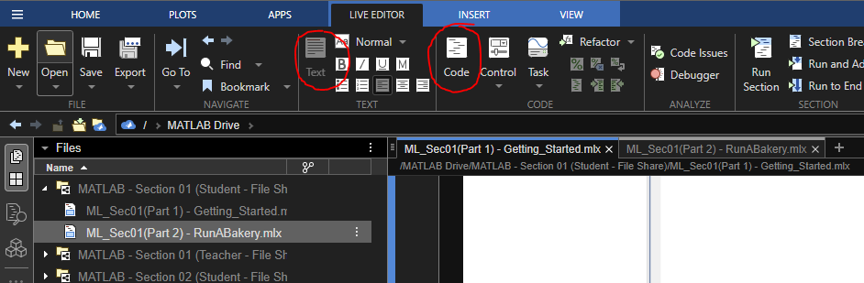
Getting Started With MATLAB Onramp
Live Script
However, solving problems often involves a sequence of commands.
You can organize all your commands and their outputs together with a Live Script, which is what this file is.
To begin coding, select Code in the Toolstrip. You can enter commands in the gray code box. You can switch to text mode to add some description.

Slide 12
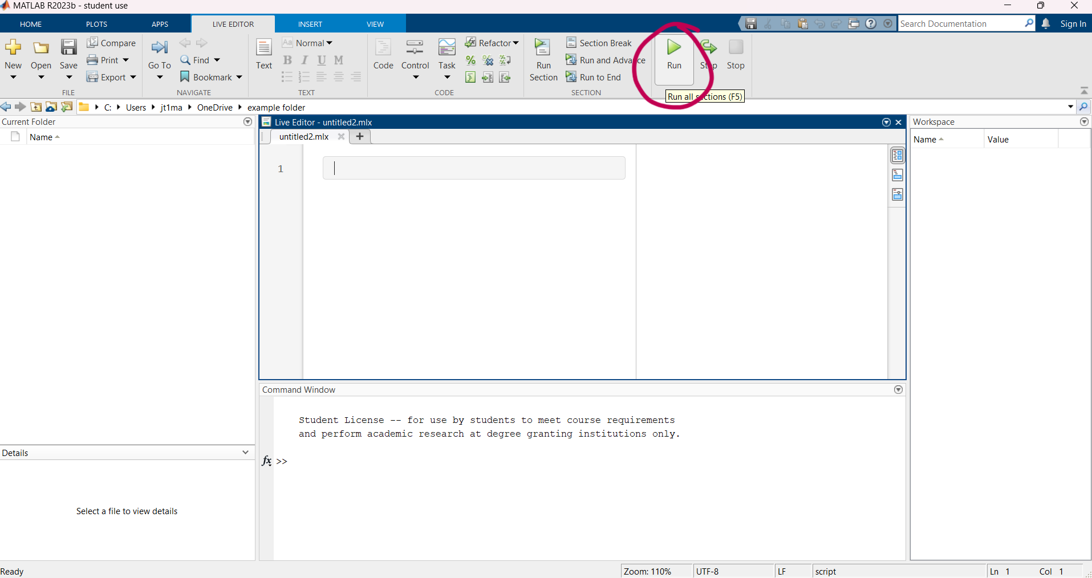
Getting Started With MATLAB Onramp
Live Script
You can now run multiple commands at once by clicking the Run button. This evaluates all the commands in order. The output appears on the pane on the right.

Slide 13
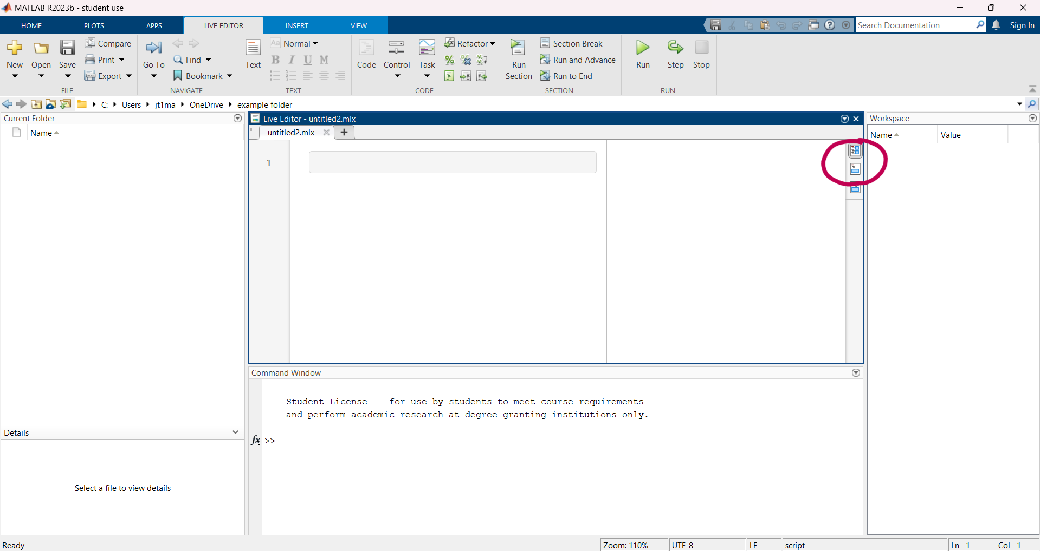
Getting Started With MATLAB Onramp
Live Script
To change the layout, you can click these 2 buttons on the top right side so that the output appears differently. Either way you can see how the code relates to the output.

Slide 14
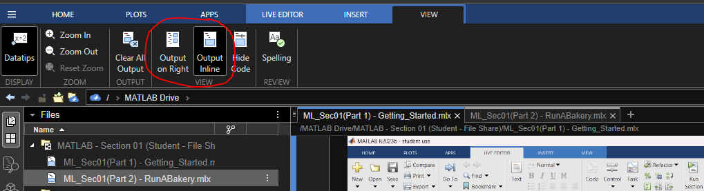
Getting Started With MATLAB Onramp
Live Script
You can also select the Output style in the "View" tab at the top:

Slide 15
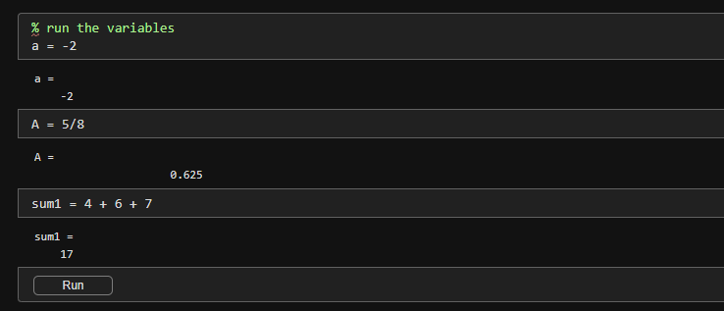
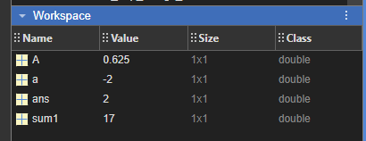
Getting Started With MATLAB Onramp
Variables
You can name your MATLAB variables anything you'd like as long as they start with a letter and contain only letters, numbers, and underscores (_).
When you create variables, they are saved in the workspace.
Notice that the variables a and A both exist in the workspace.

Slide 16
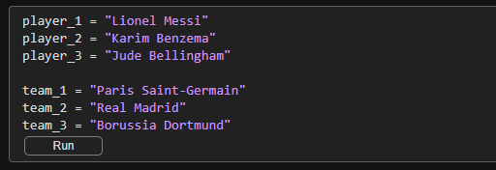
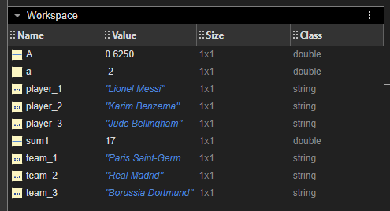
Getting Started With MATLAB Onramp
Variables
What if I wanted to store the names of some players or teams?
If you run the section above, you can see that all the names are saved in the workspace in the bottom left.
The names are saved as "string" class variables, since we created them in quotes and they are non-numerical, meaning we are limited in what we can do with them.

Slide 17
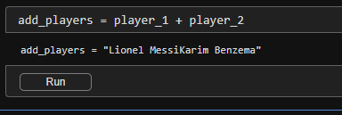
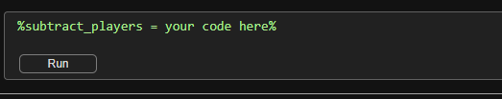
Getting Started With MATLAB Onramp
Variables
What if we tried to add two strings together like we do numerical "double" variables?
Now you try!
Why don't you try subtracting the names instead of adding, do you think this will work? Why or why not?

Slide 18
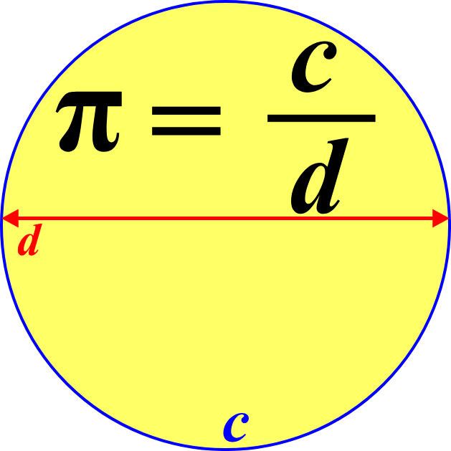

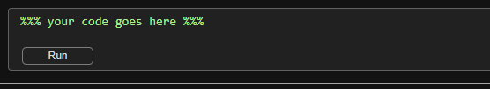
Getting Started With MATLAB Onramp
Constants
MATLAB contains built-in constants, such as pi to represent π.
If you were to type in pi into the command window, the output shows only four decimal places for pi, but MATLAB internally represents the built-in constant with more decimal places.
You try!: Create a variable a with a value of π/2. You should also notice that your new command replaced the previous a.

Slide 19
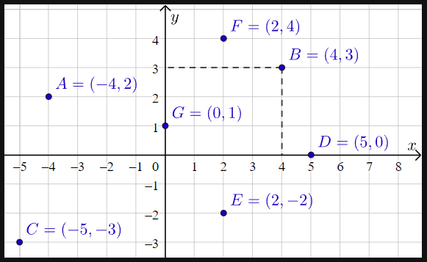
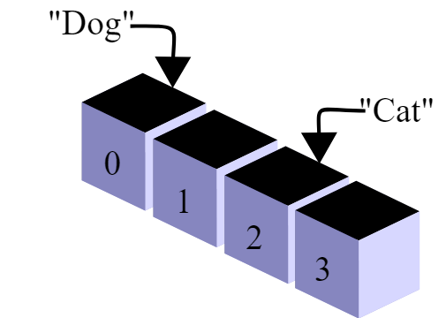
Getting Started With MATLAB Onramp
Arrays
Arrays are a way of storing information in columns and rows.
Think of coordinates on a coordinate plane. If you wanted to extract information at a certain point, you’d first have to specify the coordinates where the point exists.

Slide 20
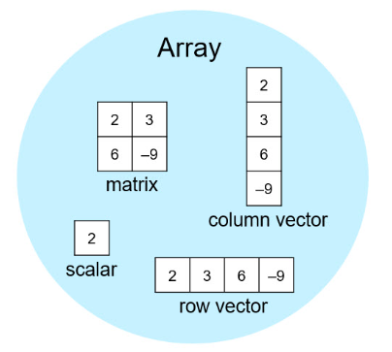
Getting Started With MATLAB Onramp
Arrays
All MATLAB variables are arrays. So, each numeric variable can contain multiple numbers.
You can store related data in one variable by using an array.
Because arrays are a basic programming tool in the MATLAB language, it's important to get to know them and the terminology used to describe them.

Slide 21
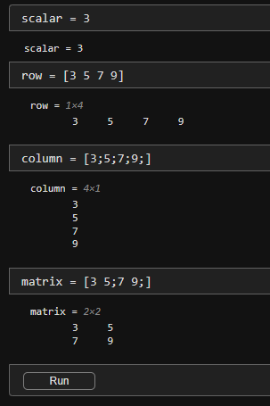
Getting Started With MATLAB Onramp
Arrays
You can create arrays with multiple elements using square brackets.
When you separate numbers by using spaces as shown in the previous task, MATLAB combines the numbers into a row vector, which is an array with one row and multiple columns (1-by-n).
When you separate numbers by using semicolons, MATLAB creates a column vector (n-by-1).

Slide 22
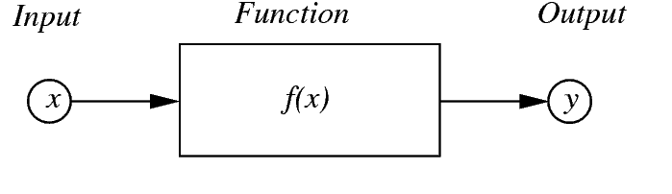
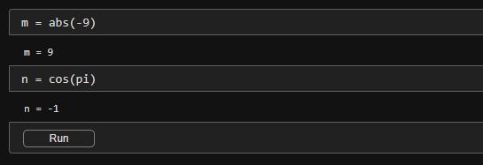
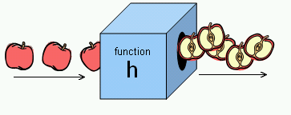
Getting Started With MATLAB Onramp
Functions
MATLAB contains a wide variety of built-in functions, such as abs (absolute value) and cos (cosine).
Pass inputs to functions by using parentheses, similar to function notation in math. You can assign these functions to variables.

Slide 23

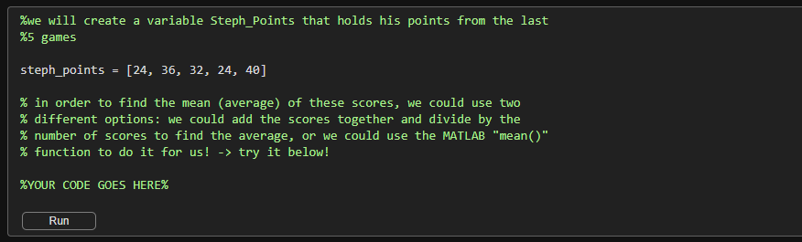
Getting Started With MATLAB Onramp
Practice Time!
What if we make a variable that holds the amount points Stephen Curry scored in the past 5 games and we want to take an average?
We could use an array and a function for this! Fill out the missing lines of code to do this below!

Slide 24
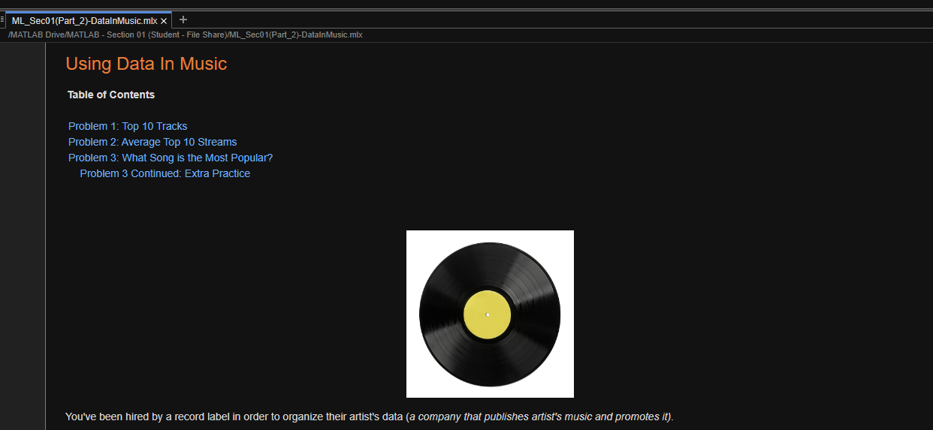
Using Data In Music!
After going through the MATLAB Onramp live script, let’s practice what we have learned by completing the Part 2 live script also found in the MATLAB Drive for this section.
This file will be in the same folder as the previous file, and labeled as ML_Sec01(Part 2) – DataInMusic.mlx
The MATLAB files for this section can be found at this link.
Notes:
The URL on this slide is for the student version of the files, please see the teacher guide for the teacher version of the files You can also find the teacher and student links on the master document with all the youtube video and matlab drive links for every section on it

Slide 25

Using Data In Music!
Introduction
You've been hired by a record label in order to organize their artist's data (a company that publishes artist's music and promotes it).
Before getting started, think about how you would store the following items, and what data types they would be:
What data type would an artist’s name be?
How would you store albums, as a list/array of songs?
How would you store the amount of listens or streams a song gets?

Slide 26
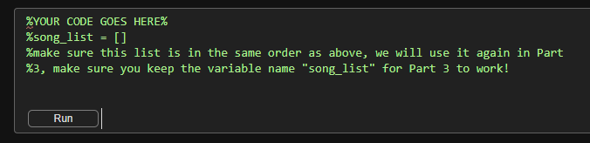
Using Data In Music!
Problem 1: Top 10 Tracks
The record label wants you to organize the top 10 most popular tracks in the US today.
Create a variable that stores the names of each of the following songs:
A Bar Song
Please Please Please
Nasty
Not Like Us
I Had Some Help
BIRDS OF A FEATHER
MILLION DOLLAR BABY
Good Luck, Babe!
Houdini
Espresso

Slide 27
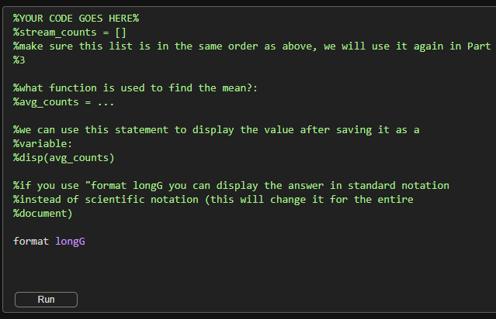
Using Data In Music!
Problem 2: Average Top 10 Streams
The record label is interest in knowing the average amounts of streams/listens that songs in the top 10 are reaching.
To do this you will need to store the number of listens from each song in a variable and find the mean average. Here are the number of listens below:
A Bar Song: 328,558,379
Please Please Please: 98,201,064
Nasty: 36,651,626
Not Like Us: 338,868,818
I Had Some Help: 266,320,519
BIRDS OF A FEATHER: 242,086,893
MILLION DOLLAR BABY: 416,636,466
Good Luck, Babe!: 187,070,573
Houdini: 126,246,936
Espresso: 580,570,678

Slide 28
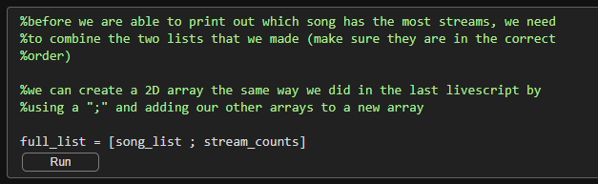
Using Data In Music!
Problem 3: What Song is the Most Popular?
The record label wants you to see which of these songs is the most popular, which means we need to learn some new techniques!
Follow along with the coding cells below and make use of what you created in Problem 1 and 2.
Let’s start by creating a 2D array out of the lists from Problem 1 and 2.

Slide 29
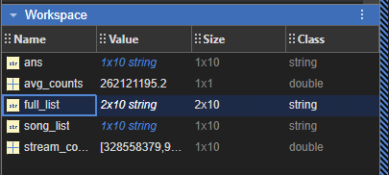
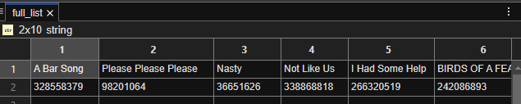
Using Data In Music!
Problem 3: What Song is the Most Popular?
You can make sure that this line of code did what it was supposed to by opening the variable it made in the workspace.
Double click on the name "full_list" in the workspace and it will open a spreadsheet of the values in their respective rows:

Slide 30
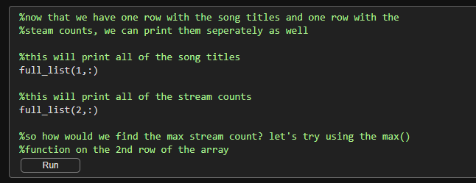
Using Data In Music!
Problem 3: What Song is the Most Popular?
In order to triple check our new 2D array, we can even print the rows individually.
The first row will be the names of the song and the second row will be their respective stream counts.
Since we typed them in order, the first song in row one will have the stream counts of the first number in row two.

Slide 31
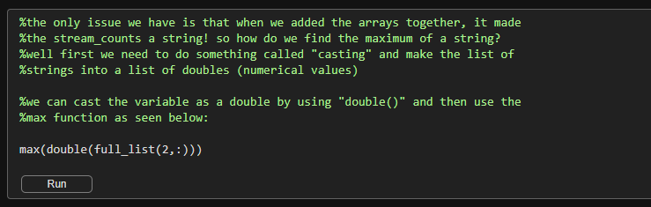
Using Data In Music!
Problem 3: What Song is the Most Popular?
We will now practice what is called “casting” by changing the string variables that we created by adding our stream counts to the 2D array.
We can cast these values back to doubles so we can find the maximum value. We cannot use max() on string values!

Slide 32
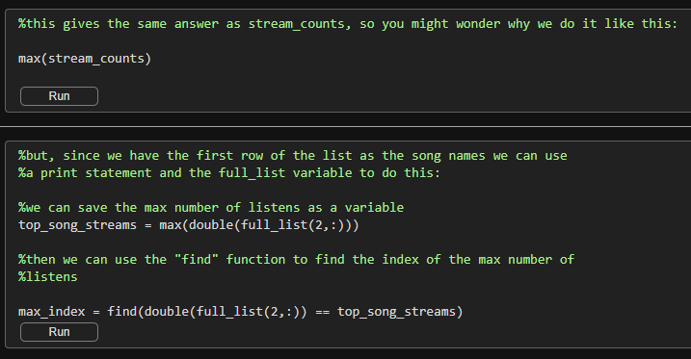
Using Data In Music!
Problem 3: What Song is the Most Popular?
While we could use the previous array, since it only contains the stream counts, that are already numerical, we want the song name in the row above that is paired with the correct number of streams in the second row, so we use the array that has both.
This will be more important once we have data that comes in 2D arrays already, like spreadsheets.

Slide 33
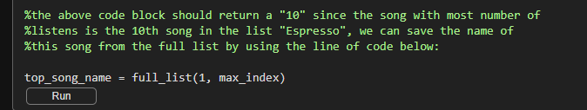
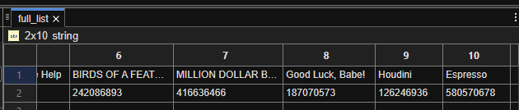
Using Data In Music!
Problem 3: What Song is the Most Popular?
Now that we have the index of the value in the array that has the largest song count, we can go back to the first row and use that index to find the song title that is in the same spot in the row above.
Since max_index will equal “10” it will grab the tenth song name “Espresso” from the array. We can run this cell to double check this value.

Slide 34
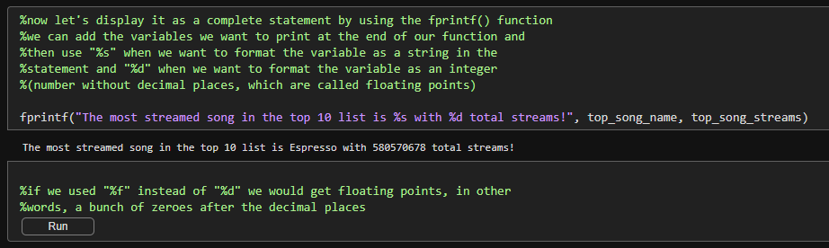
Using Data In Music!
Problem 3: What Song is the Most Popular?
Lastly, we can take the name of the song and the song steam counts that we grabbed from the array and use a new tool called the “fprintf()” function in order to print out a phrase along with the values.
Take a look at the coding cell below to see how variables are input into the sentence using “%s” and “%d” depending on whether the variable is a string or an integer.

Slide 35
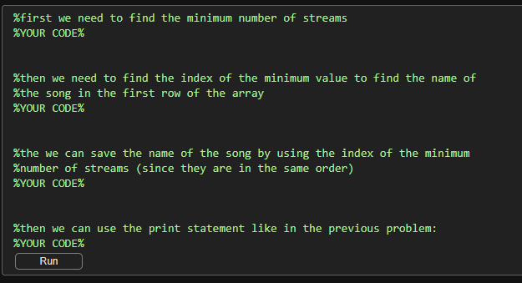
Using Data In Music!
Problem 3 Continued: Extra Practice
Congratulations, you have completed your task for the record label!
Now, in order to practice your new skills, try the “Extra Practice” task at the end of the live script!
Now that you know about indexing a 2D array (a list with rows and columns), and how to format a print statement, why don’t you try finding the stream count and name of the least listened to song in the list!

Slide 36


Choosing the Parameters That Matter
Now that we have got some practice with both sports and music data, think about the videos that we watched at the beginning of this lesson about predicting the success of an athlete or the next hit song.
Let’s complete the following activity:
1. Get together with a group or partner and choose whether you want to predict the next best athlete (and what sport they play), or whether you want to predict the next hit song.
2. Think about what parameters (variables) and what types of data you need to focus on and collect. (Is it the number of goals, the number of streams? Are these numerical values like doubles or strings?)
3. Create a list of the top 5 most important parameters for your prediction and include why it is important. (feel free to add more than 5!)
4. Share your parameters with the class!

